Slide 1

Spark Fundamentals

Slide 2
Spark History
Started by Matei Zaharia at UC Berkeley's AMPLab in 2009
Open sourced in 2010
Donated to Apache software foundation and licensed as Apache 2.0
Now it has more than 1500 contributes and multiple communities
Many companies are adopting Apache spark to innovate their Big data use cases

Slide 3
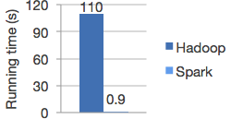
Lightning-fast in-memory computation engine for large-scale data processing
What is Spark
Speed
Run workloads 100x faster.
Logistic regression In Hadoop and Spark

Slide 4
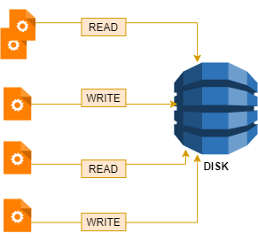
Lightning-fast in-memory computation engine for large-scale data processing
What is Spark
1
Higher Bandwidth (I/O)
2
Higher Latency
3
External Job scheduler
Hadoop Data processing

Slide 5
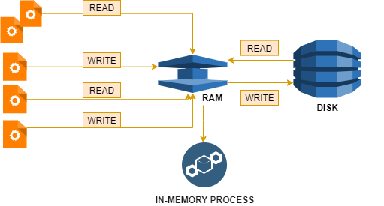
Lightning-fast in-memory computation engine for large-scale data processing
What is Spark
1
Lower Bandwidth (I/O)
2
Lower Latency
3
No External Scheduler

Slide 6
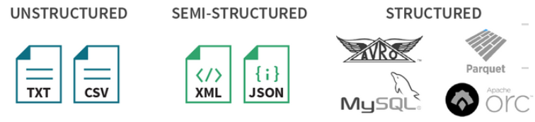
Lightning-fast in-memory computation engine for large-scale data processing
What is Spark

Slide 7
Spark Components
1
Spark CORE
Core engine for large scale parallel and distributed data processing. Spark RDD-Resilient Distributed Dataset
2
Spark SQL
Distributed framework for structured data processing. Spark Dataframe and dataset
3
Scalable, high throughput and fault tolerant processing of streams of data. Dstreams
Spark Streaming
4
Spark ML
Scalable Machine learning library for various algorithm with high speed
5
Spark GraphX
Parallel processing engine for network graphs and data store

Slide 8
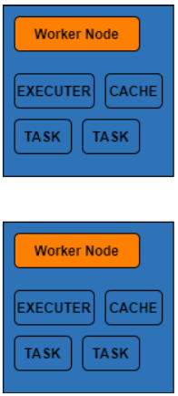

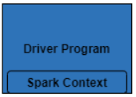

Spark Architecture
Want to process data

Slide 9
Driver program:
Creates the Spark Context object. It coordinate the spark applications.
Negotiate the resources with cluster manager
Sends application code to executors like jar, python files
Spark context sends task to executors to run
Cluster manager:
Allocates resources across the application
It can be either Hadoop yarn, apache mesos, spark standalone, Kubernetes
Worker node:
Slave node to run the application code in cluster
Executors:
Runs the task and keeps the data in memory or disk
Task:
Unit of task given to executors for running

Slide 10
Happy Learning see you again☺

